Slide 1
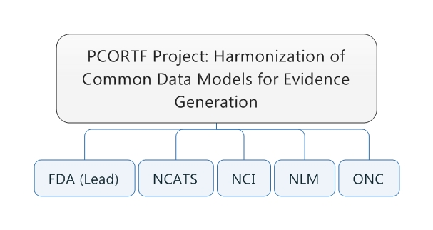
Contents
PCORTF: The Common Data Model Harmonization Project
Real World Data and the PCORTF Common Data Model Harmonization Project

Slide 2
Contents
Current State and Desired State of RWD for FDA
Phase I: Common Data Model Harmonization Project
Phase II: Pluri-Potent Data Model

Slide 3

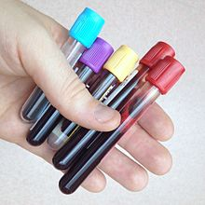


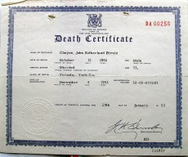
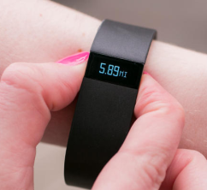
Real World Data Uses for Clinical Trials
Claims Data
Rapidly find large numbers of possible participants with all requirements for clinical trial study
Health history
Treatment history
Medicine history
Range of demographics
Range of geographies and rural/urban
Rapidly identify site/investigators
Savings of time and money for manufacturers, clinical investigators, and other stakeholders
Potential to identify additional “off-label” uses for approved drugs
Laboratory
Results
Electronic Health Records
Real World Data
Vital Records
and Registries
Pharmacy
Mobile Health Devices

Slide 4
Current State for Real World Data (RWD)
Thousands of real-world data systems (EHRs, claims data, etc.)
Limited data connection to FDA research systems
Cannot effectively conduct large scale RWD research
Cannot get aggregate different RWD CDMs
Cannot get timely access to RWD CDMs

Slide 5
Ideal State for Real World Data
Real-time access to real world data systems accessible to FDA researchers:
Secure
Privacy protected / de-identified
Sources retain ownership and control of raw data
Crosses demographics, geography, etc.
Mechanisms to get rapid answers to research questions from pools of millions of patients
Without risk of any privacy breach
Results are de-identified

Slide 6
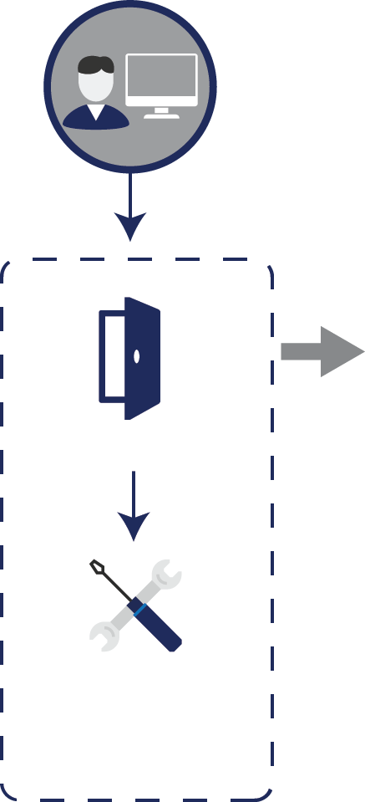

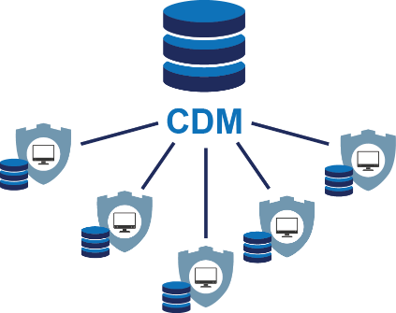
Current State: Multiple RWD Networks
Large RWD Networks (PCORNet, Sentinel, OMOP, i2b2/ACT)
Use different data models with limited interoperability
Network have some unique and some overlapping patients populations
No single portal to query all networks
Inability to aggerate results data across networks
Q
Sentinel
A
19 Data Partners*

Slide 7
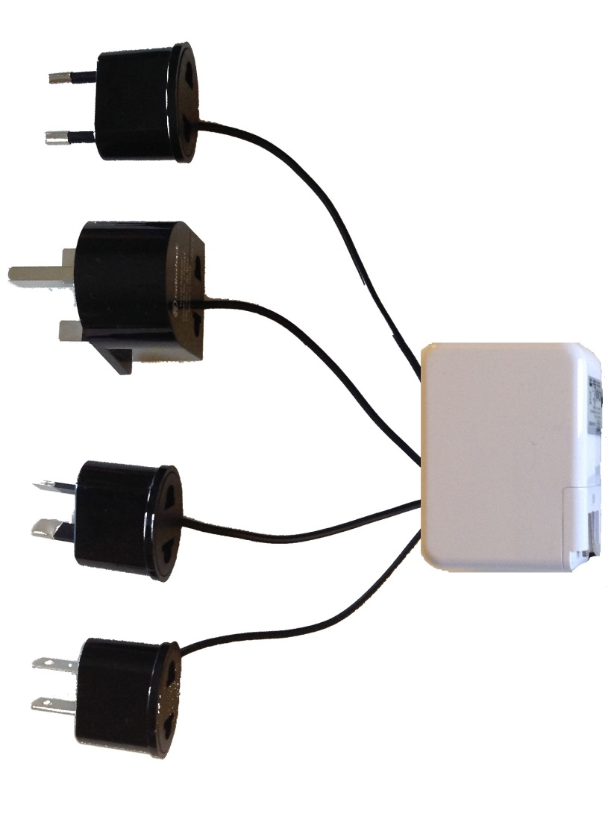
The solution CDM ‘Adapter Model’
Use a converter between various adapters.
Allow researchers to ask a question once and receive results from many different sources using a common agreed-upon standard structure, or a Common Data Model.
Sentinel
i2b2/ACT
PCORNET
OMOP

Slide 8
PCORTF CDM Harmonization Project
Goal:
Build a data infrastructure for conducting research using Real World Data derived from the delivery of health care in routine clinical settings.
Objective:
Develop the method to harmonize the Common Data Models of various networks, allowing researchers to simply ask research questions on much larger amounts of Real World Data than currently possible, leveraging open standards and controlled terminologies to advance Patient-Centered Outcomes Research.

Slide 9



The Concept
OHDSI/OMOP
Sentinel
FDA, PCOR, and other Researchers
19 Data Partners*,
Records: 375 Mil
14 Data Partners*,
Records: 650 Mil
PCORNET CDM
Portal
i2b2
Tools
Mechanism to crosswalk the models
13 CDRN + 21 PPRN*,
Records: 72 Mil
> 60*, Records: 100 Mil

Slide 10


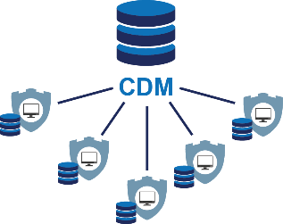
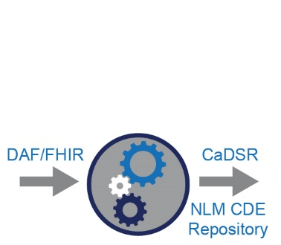



Extended Solution
Develop a general framework (i.e., tools, processes, policies, and standards) for the transformation of various CDMs, curation, maintenance and sustainability.
Input
Output
FDA, PCOR, and other Researchers
Sentinel
OHDSI/OMOP
CDISC Standards
19 Data Partners*
14 Data Partners*
Portal
PCORNET CDM
i2b2
Extract Transform Load (ETL)
FHIR Standards
Tools
Mechanism to crosswalk the models
13 CDRN + 21 PPRN*
> 60*

Slide 11
Phase I: Adaptor Model

Slide 12
Phase I: Adaptor Model Deliverables
Software development
Query Builder: Gives researcher ability to construct their queries
Query Transformation: Transforms the single query into the multiple CDM versions of the query
CDMH Results Database and Viewer: To receive and analyze results of a query in one or more of the CDM formats
SDTM export: To export record level results into FDA-compliant STDM format.
Transformational Mappings
CDMs-to-BIRDG mappings: This provides the rules for transforming from any of the CDMs to a common transitional model (BRIDG)
CDMH/BRIDG-to-SDTM mapping: This provides the rules to export results in support of submissions to FDA
CDMH/BRIDG-to-FHIR mapping: This provides the alignment and gaps of the CDMs to existing FHIR resources.
Initiation of development of FHIR extensions and profiles: Allows implementation with FHIR, built from CDMH-to-BRIDG mapping, to be balloted at HL7.
RxNorm to NDC mapping: Allows mapping of drugs in the most widely used reference database (RxNorm) to the specific formatting and content required for FDA submissions
PCOR Research Community Support
Oncology Use Case Query Development: Development of a query based on the Oncology
Registration of cross-mappings to NCI enterprise vocabulary service EVS: Entry of the Transformational Mappings (above) into NCIs Cancer Data Standards Registry and Repository (CaSDR)
BRIDG Updated with CDMH Data Elements: The BRIDG model was updated to include concepts of the mapped CDMs, promoting implementation strategies for use of BRIDG with the various CDMs allowing use of the BRIDG model in CDM projects as well as linking the CDMs to FHIR and SDTM via BRIDG
Education and Data Governance: Initiation of work to build governance, policy and educational material for use of the CDMH tools. This material will describe the process, for using the CDMH solution, as well as the educational material for using the tools

Slide 13
Phase I: Adaptor Model Problems
Multiple Query Flavors

Slide 14
Phase I: Adaptor Model Problems – CDM’s
Reduce loss of data integrity and granularity
Decrease complexity and eliminate need to build separate queries for each data model and proprietary databases
Reduce Maintenance by implementing HL7 FHIR standards, eliminates dependence on CDMs and mapping
CDM
(PCORnet, OMOP, Sentinel, ACT/i2b2)
FHIR

Slide 15
Phase II - FHIR Model: Common Query
Leveraged Query Translator to transform the CDMH query into a “FHIR Query”

Slide 16
Phase II - FHIR Model: FHIR Server
*Institution runs FHIR query against de-identified FHIR Server

Slide 17
Phase II - FHIR Model: Results
Results Loaded into a staging database
*New Development (FDA)

Slide 18
Phase II - FHIR Model: Transformation
FHIR Results → PCORI, OMOP, i2b2/ACT Sentinel and BRIDG

Slide 19
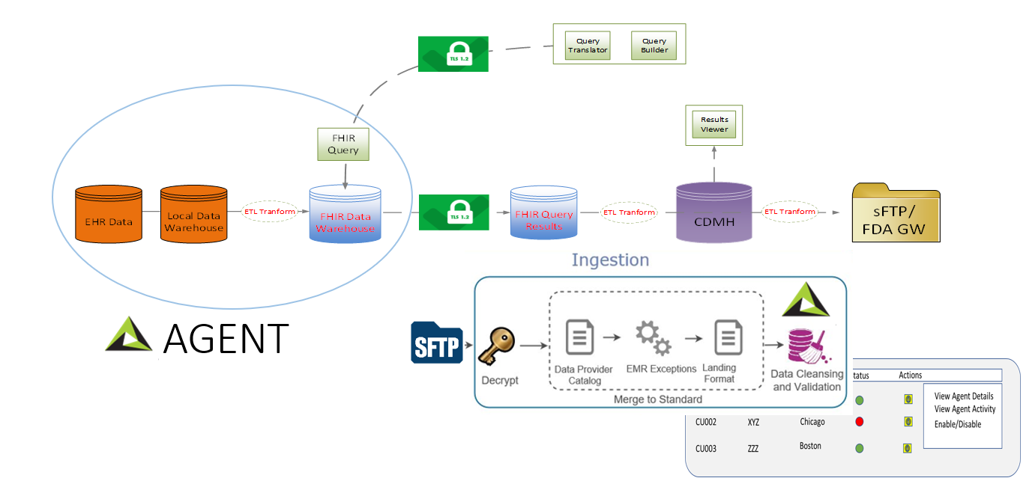
Phase II - FHIR Model: Agent
Agent includes: local ETL, de-identification process, FHIR Server, management oversight

Slide 20
END

